Slide 1
Big Mountain Resort Pricing Strategy Analysis, Executive Strategy
05/03/2024, Yuntian Zuo

Slide 2
Challenges Impacting Revenue Growth
- Big Mountain Resort faces significant challenges in its current pricing strategy, which has not been updated to reflect the enhancements made to the resort and its amenities. Despite superior service quality and facilities, our prices remain aligned with lower-tier competitors, which impedes our revenue potential and market position. This misalignment also risks diminishing the perceived value of our offerings, potentially affecting customer satisfaction and brand reputation in an increasingly competitive market

Slide 3
Strategic Pricing Recommendation
- After a thorough analysis of market trends and competitor pricing, we recommend increasing the base ticket price to $97.96. This price adjustment is projected to boost our revenue by up to 20% without risking significant loss of demand. The proposed price reflects the value provided by recent upgrades to our facilities, including expanded runs and enhanced snow making capabilities. Aligning our ticket prices with the premium experience we offer will reposition Big Mountain Resort as a leader in the industry, attracting a demographic that values quality and is willing to invest in superior ski experiences.

Slide 4
Overview of Predictive Modeling
- To derive an optimal pricing strategy, we employed a Random Forest Regressor model, recognized for its efficacy in handling complex, nonlinear data with multiple input features. This model was trained on a comprehensive dataset excluding our current pricing data to avoid bias. Key factors such as vertical drop, number of runs, and snow making capabilities were identified as significant predictors of ticket pricing. The model's accuracy was validated through rigorous cross-validation techniques, ensuring the reliability of our recommended pricing strategy.

Slide 5
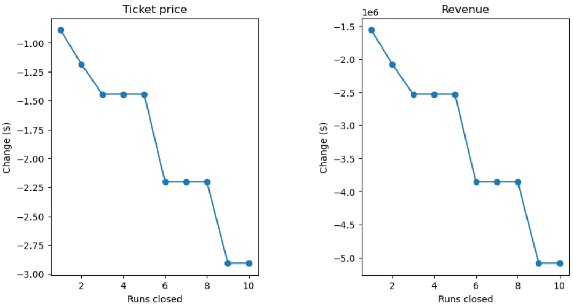
Financial Impact of Strategic Scenarios
We conducted a scenario analysis to understand the financial implications of various strategic changes. Increasing the vertical drop by 150 feet could justify a price increase of $3 per ticket, enhancing the appeal of our runs. Similarly, expanding our snow making coverage by 40 acres supports a $2 increase in ticket prices, significantly improving early and late season skiing conditions. These enhancements not only align with consumer expectations but also set us apart from competitors, adding to the allure and uniqueness of our resort.

Slide 6
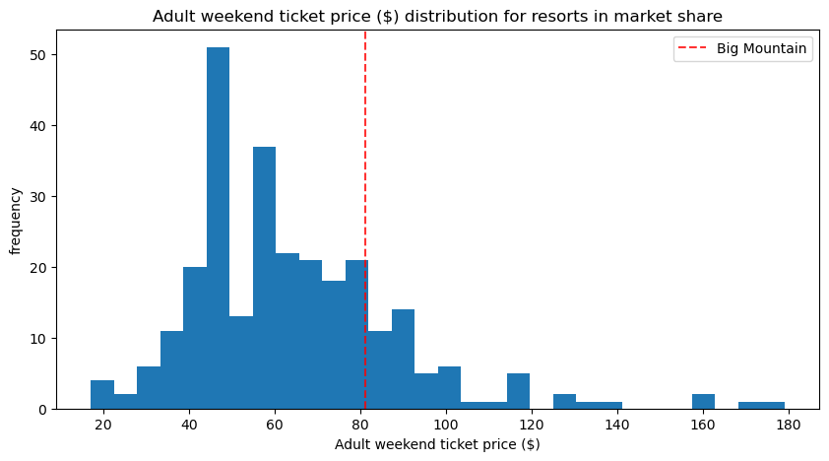
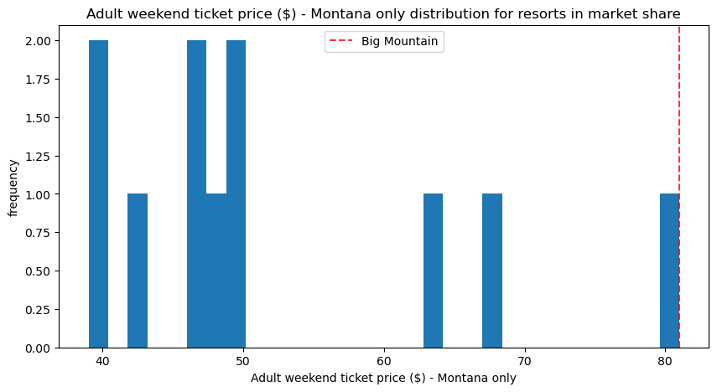
Competitive Analysis and Market Positioning
- Our competitive analysis highlights a discrepancy between our pricing and the amenities we offer compared to our main competitors. Currently, our ticket prices are on average 15% lower than resorts offering similar or inferior facilities. By reevaluating our pricing strategy, we can shift our market positioning towards a more premium segment. This shift is supported by our resort's reputation for quality and the recent investments in enhancing our visitor experience, making a compelling case for higher pricing.

Slide 7
Conclusion and Next Steps
- To capitalize on the investments made in improving the resort and to ensure sustainable growth, adopting the new pricing strategy is crucial. We propose a phased approach to the implementation of new pricing, allowing us to monitor customer responses and adjust strategies as necessary. Ongoing analyses will also focus on developing dynamic pricing models to maximize revenue during peak periods. This strategic pricing initiative is expected to strengthen our market position and ensure long-term profitability.

